Slide 1


Slide 2
AND, THE NOMINATIONS ARE ...
DATA ANALYTICS PROJECT (FALL 2018)
GROUP MEMBERS:
AYUSHMAAN KUMAR, WENYUE SHI,QINCHEN SUN, ANKIT YADAV, QIAOYING YUAN

Slide 3
Our Goal: Construct a Model to Predict the Next Year’s Oscar Nomination Movies
Web Scraping
Data Cleaning
Analysis
Modeling
Visualization (To see how each feature impact on the nomination) & Text Mining
Applying Logistics Model & Random Forest Model
Scraping data on various movie features from corresponding websites
Clean and merge data to into a final dataset
Notes:
Steps
Get the dataset
Visualization
Machine learning
Text mining

Slide 4
2. Data Cleaning & Merge
Web Scraping & 2. Data Preparation
Final Table
(23,243 movies,
2000 - 2017)
46 Features on Movies
Target
Genre, imdb_scores, date, runtime, certificate, etc.
Box Office, Budget
Participation times of various film festivals: TIFF, VFF, and SFF
Audience score & Critics score
Actors & Directors’ previous nomination count
Winning on other Awards: Bafta,Golden Globe, Critics Choice, AFI award
Oscar Nomination
(0 or 1)
Imdb.com
Numbers.
com
wikipedia
Rottentomatoes.com
wikipedia
wikipedia
wikipedia
Movie Keyword Dataset from kaggle.com is used for text mining analysis.

Slide 5


3. Interesting Results from Analysis
Which movie genre has the highest frequency of nomination?
Do nominated movies have longer or shorter runtime?
Do nominated movies have more positive keywords or negative keywords?

Slide 6
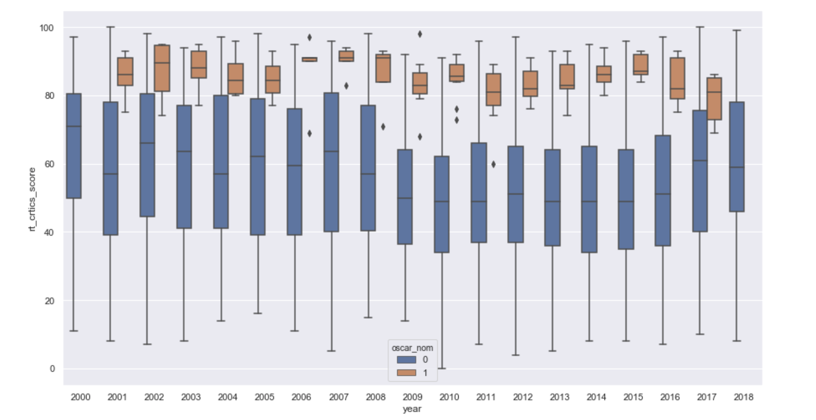
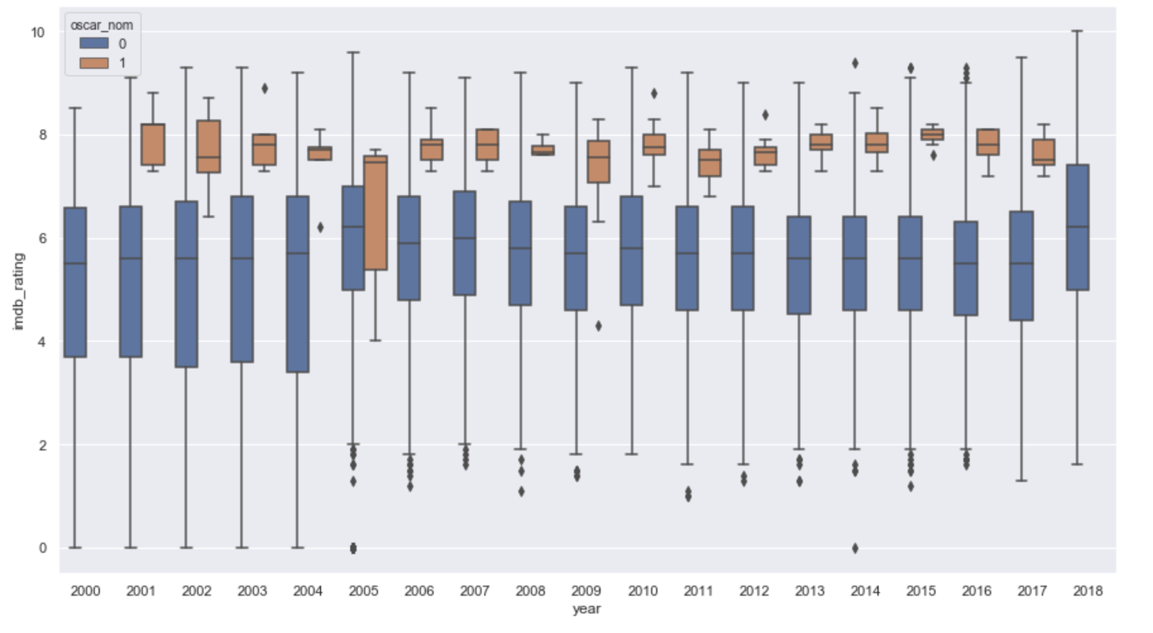
3.1.1 VISUALIZATION- Review Score
Oscar Nominees Have both Higher Critics and Higher Audience Scores
Rotten Tomato Critics Score over Years
IMDB Score over Years

Slide 7
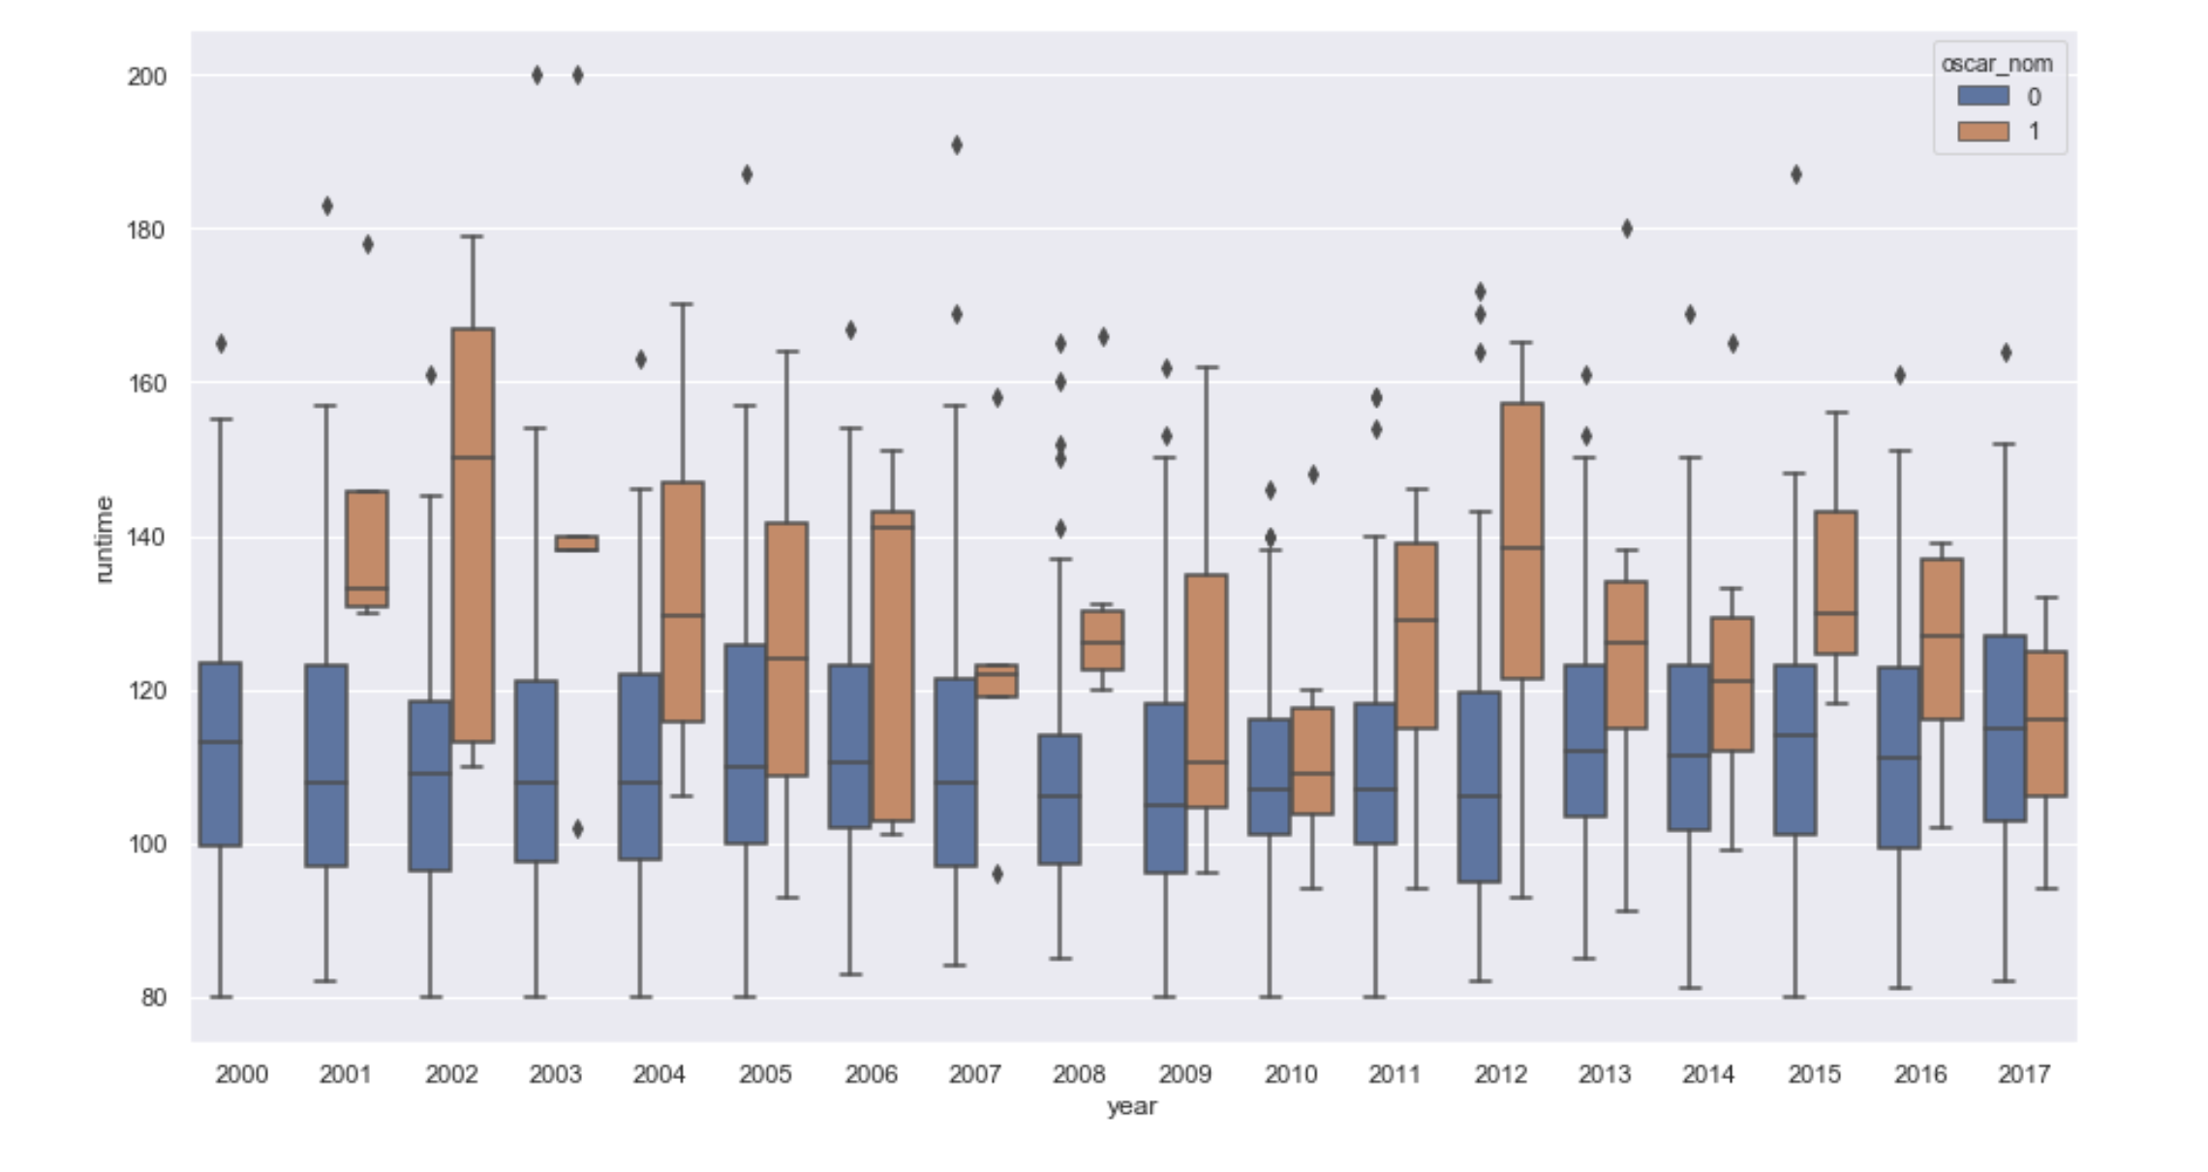
3.1.2 VISUALIZATION- Runtime
Oscar Nominees Tend to Have Longer Runtime
Runtime of Movies over Years

Slide 8
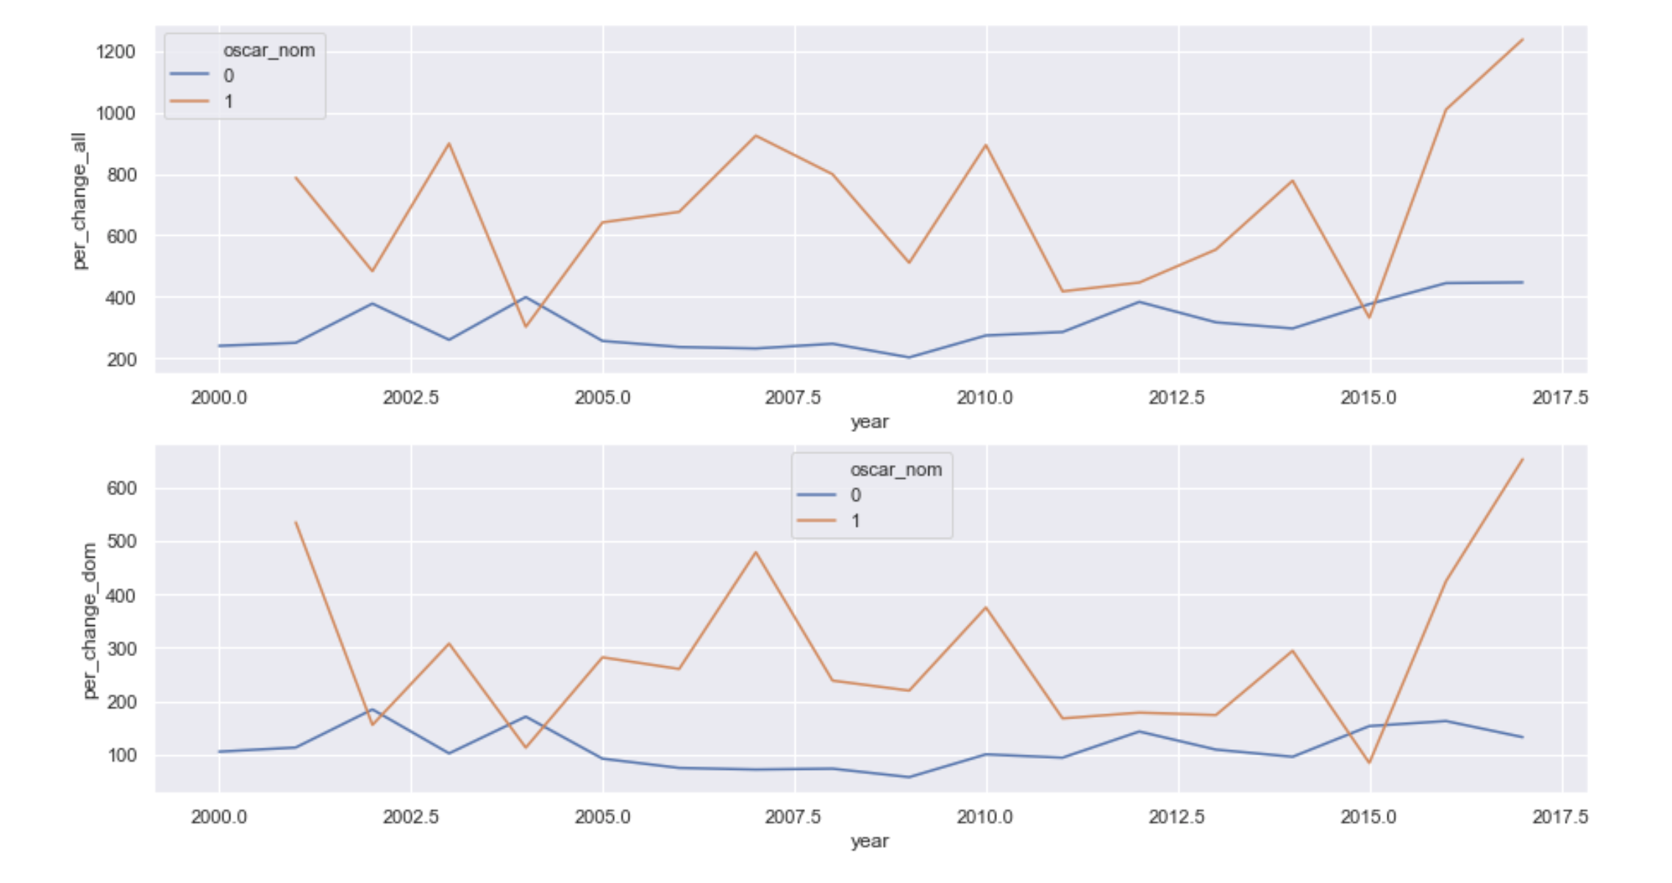
3.1.3 VISUALIZATION- Profit Margin
Oscar Nominees Usually Made More Profit in terms of Box Offices (both globally and domestically)
Global profit margins (top) & Domestic profit margins (bottom) of movies over years

Slide 9
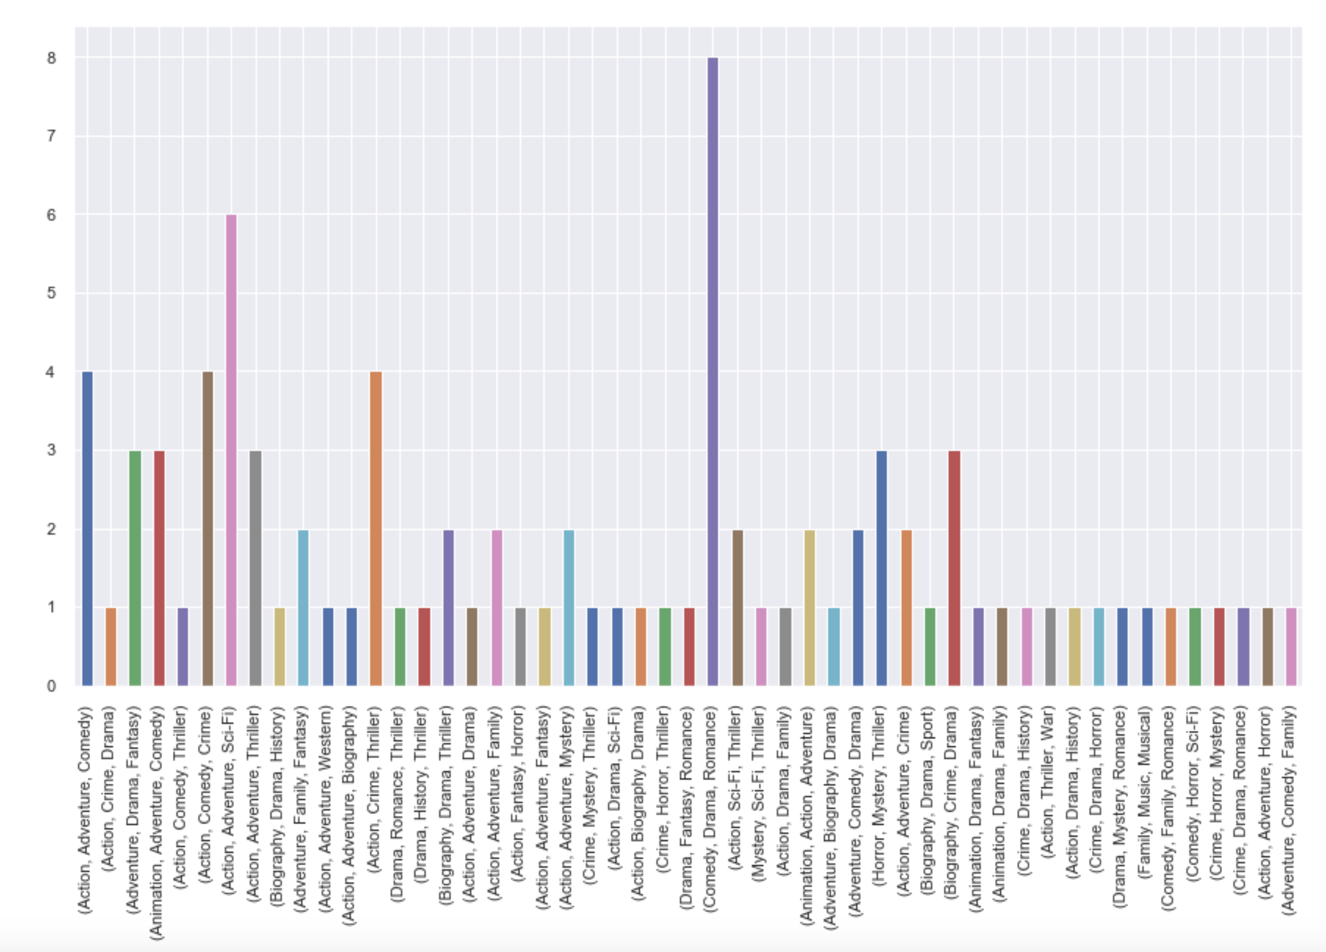
3.1.4 VISUALIZATION- Genre
(Comedy, Drama, Romance) is the Most Popular Genre Combination among Nominees
Frequencies of genre combinations of nominees

Slide 10
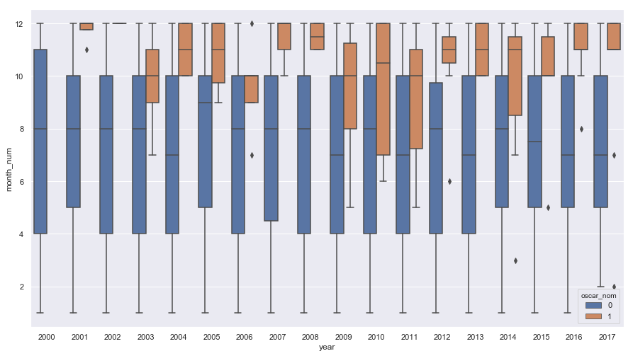
3.1.5 VISUALIZATION- Release Time
Most oscar movies release during the end of the year
Release month of all movies over years

Slide 11
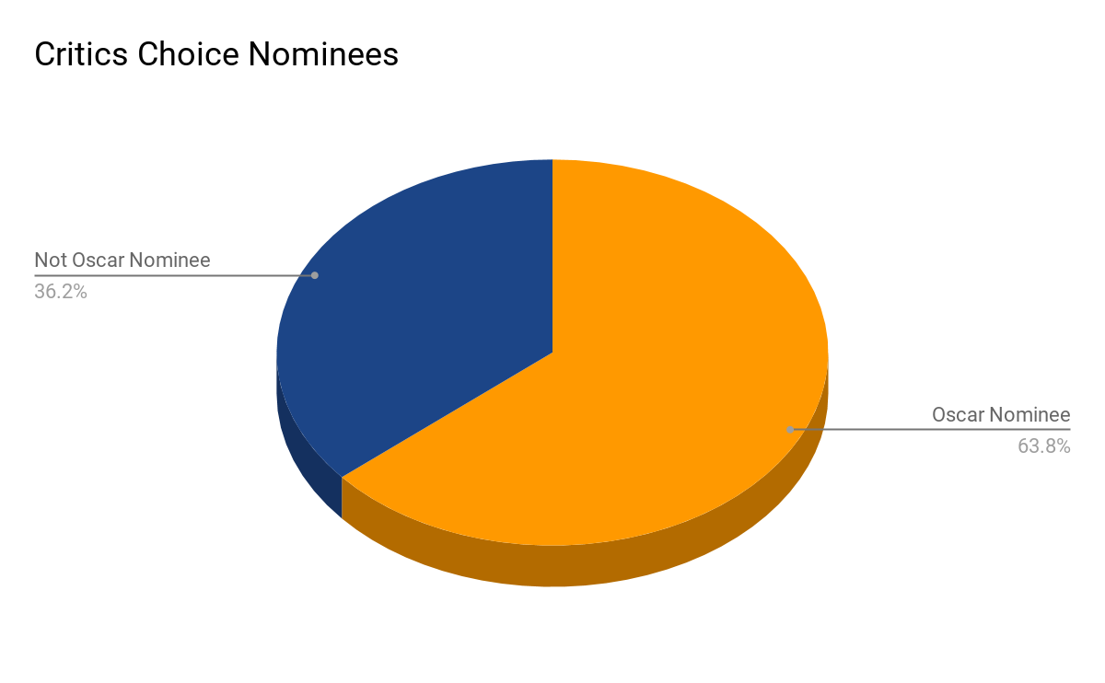
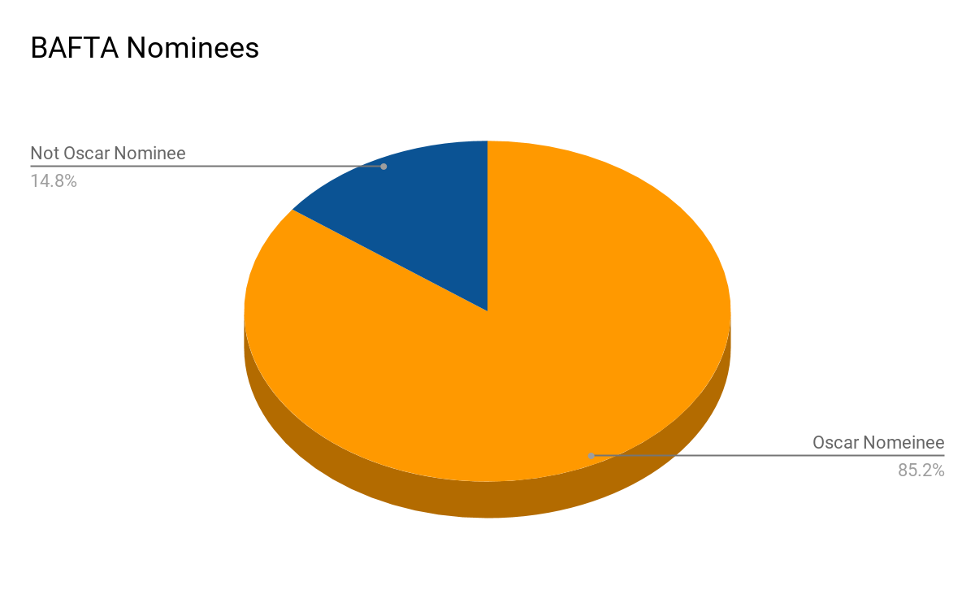
3.1.4 VISUALIZATION- Genre
Critics Choice and BAFTA Nominees have 63.84% and 85.19% likelihood to get oscar nomination

Slide 12
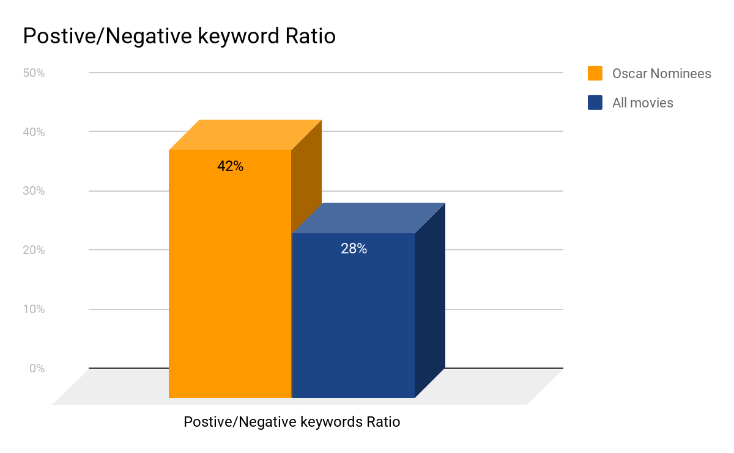
3.2 Text Mining
3.2.1 LDA Model
3.2.2 Sentiment Analysis
Oscar Nominated Movies' Topics are More Positive
Unique Topics for Oscar Nominees
“Racism”, “Gay”, ‘Biography”, etc.
Unique Topics for Not Oscar Nominees
“Blood”, “Violence”, “Murder”, etc.

Slide 13
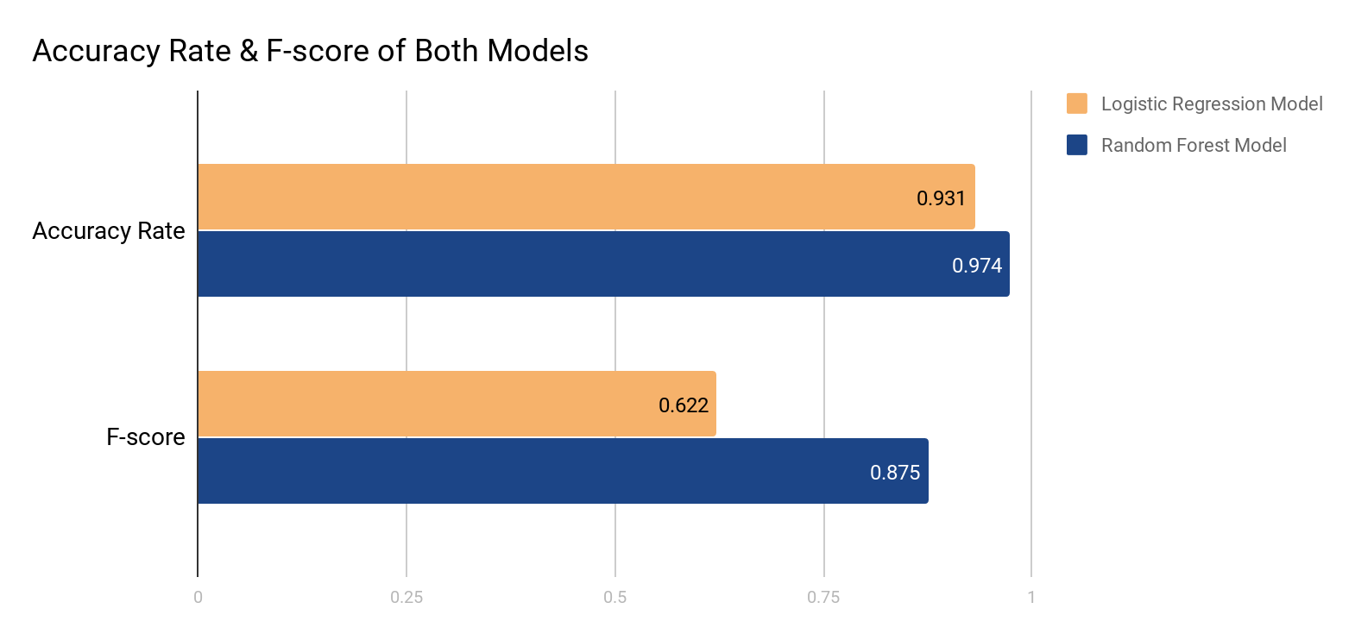
Logistic Regression Model has overall 93% accuracy rate to predict nominated & unnominated movies, Random Forest Model has overall 97% accuracy rate.
Logistic Regression Model has 62% correct rate (f-score) to predict nominated movies, Random Forest Model has 87% f-score.
4. MODELING-Random Forest Model has higher prediction accuracy than Logistic Regression Model
Trained data: year 2000-2014
Test data: year 2015-2017

Slide 14
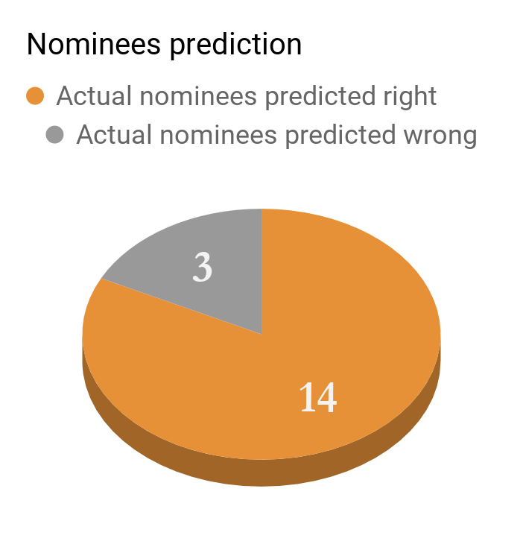
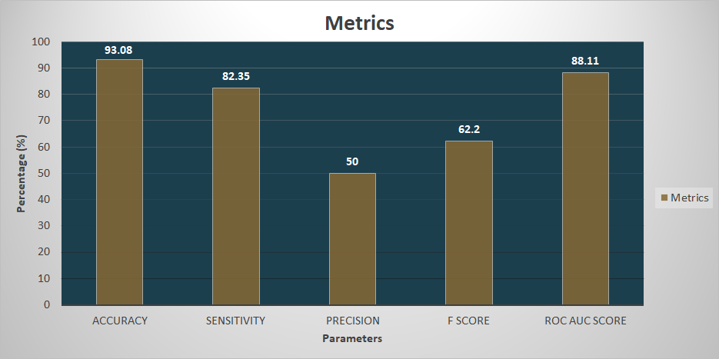
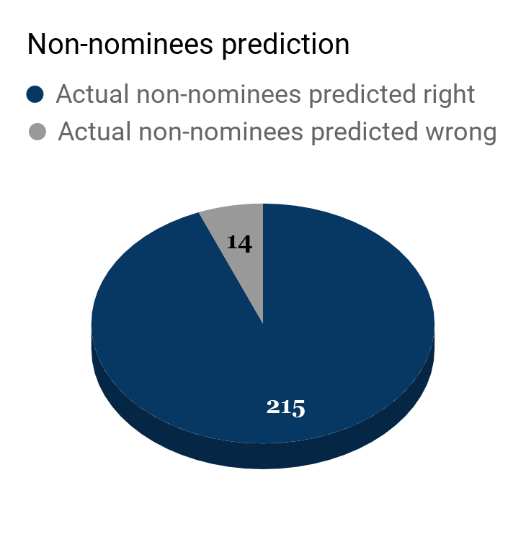
4.2 Logistic Regression Model- Prediction Result
Accuracy, Sensitivity, Precision, F-score, ROC_AUC_score

Slide 15
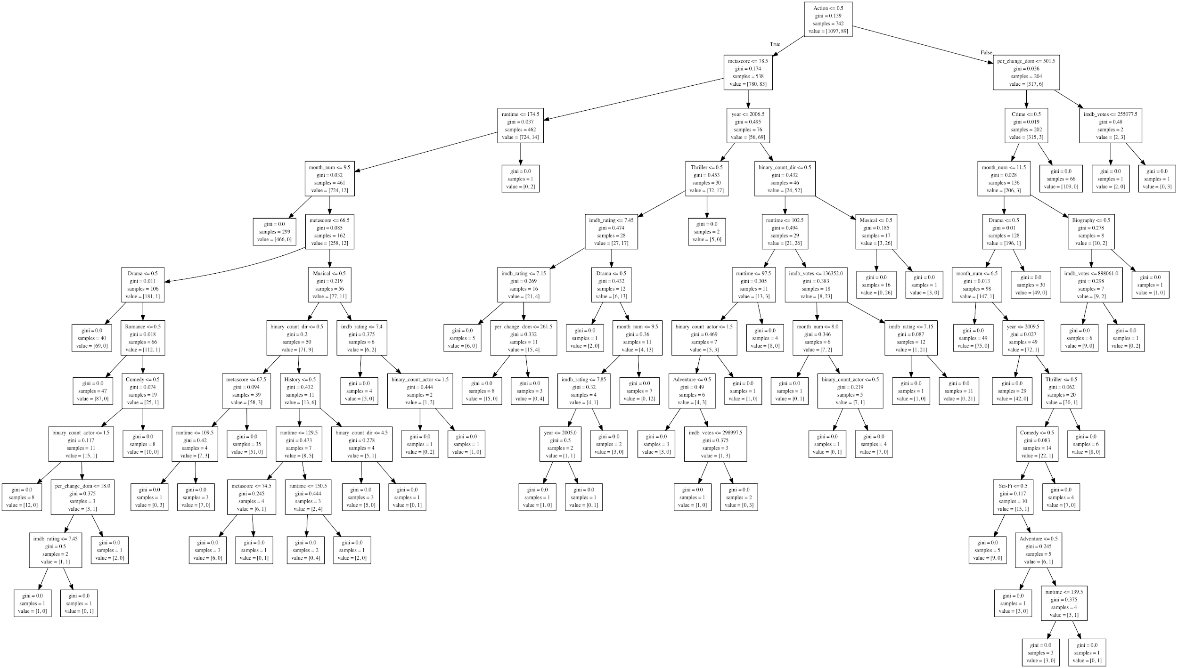
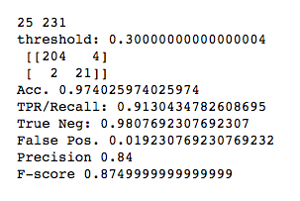
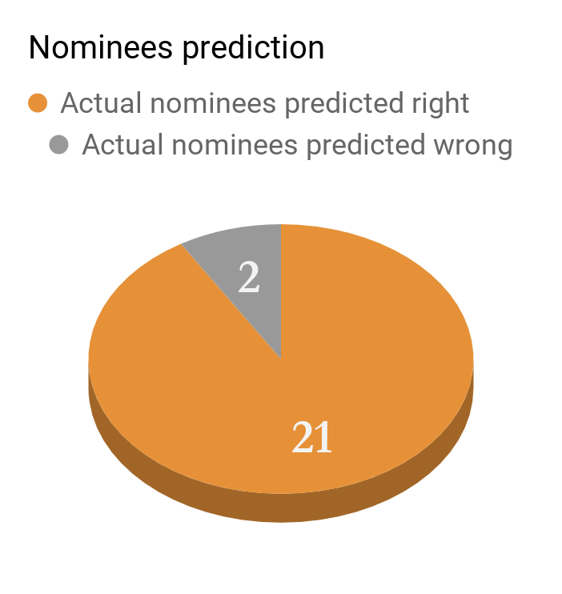
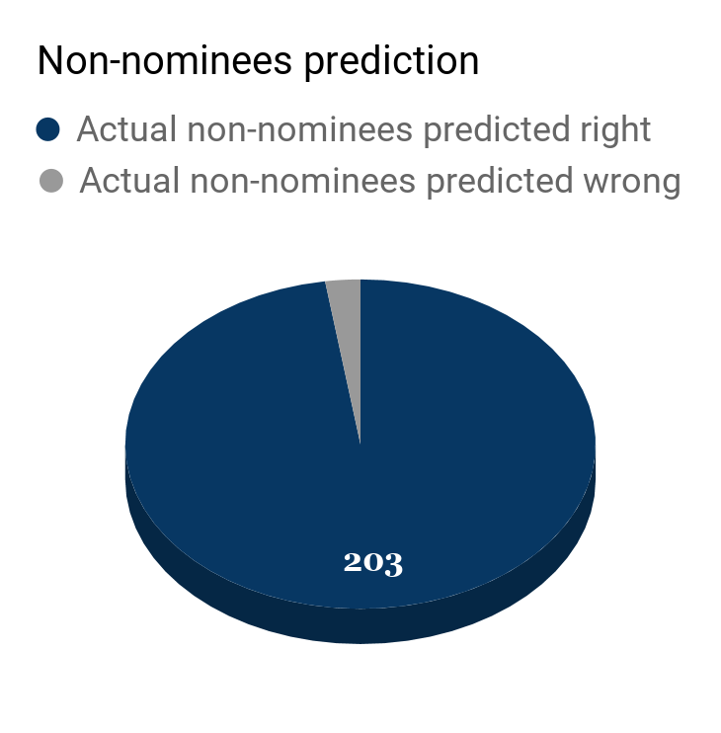
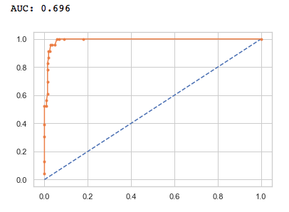
4.2 Random forest model-Prediction Result
Trained data: 2000-2014
Test data: 2015-2017
30 Trees
F-Score (harmonic
average of the
precision and recall)
= 87.5% !!!
5

Slide 16
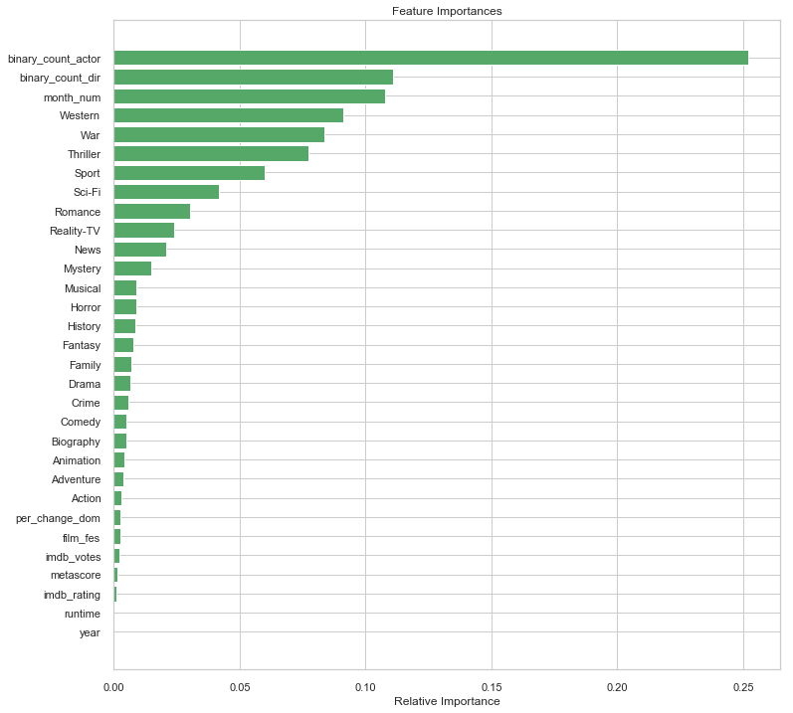
4.2 Random forest model-Prediction Result
Top interesting factors affecting Oscar Nominations:
Number of actors that have performance in nominated movies before
Number of directors’ works that have be nominated before
Movie release time ( the later of a year, the higher chance…)

Slide 17
Thank you !

Slide 18
Web Scraping
Target: oscar_nom (0 or 1)
46 features on movies:
Genre (categorical)
Participation times of various film festivals
Amount of nominations/winning times on other awards
Different kinds of scores/votes on movie review websites
actors/directors( amount of nominations in previous years)
Box_office (dom.&intl.), budget, profit margin, release time, certificate, runtime, etc.
DATA SOURCE:
Imdb.com
Rottentomatoes.com
Bafta.org
Film Festivals data: TIFF, VFF, and SFF
Oscar Actors & Directors
NUMBERS.com
Kaggle Movie Dataset
Wikipedia：Critics Choice, Golden Globe, AFI

